Slide 1

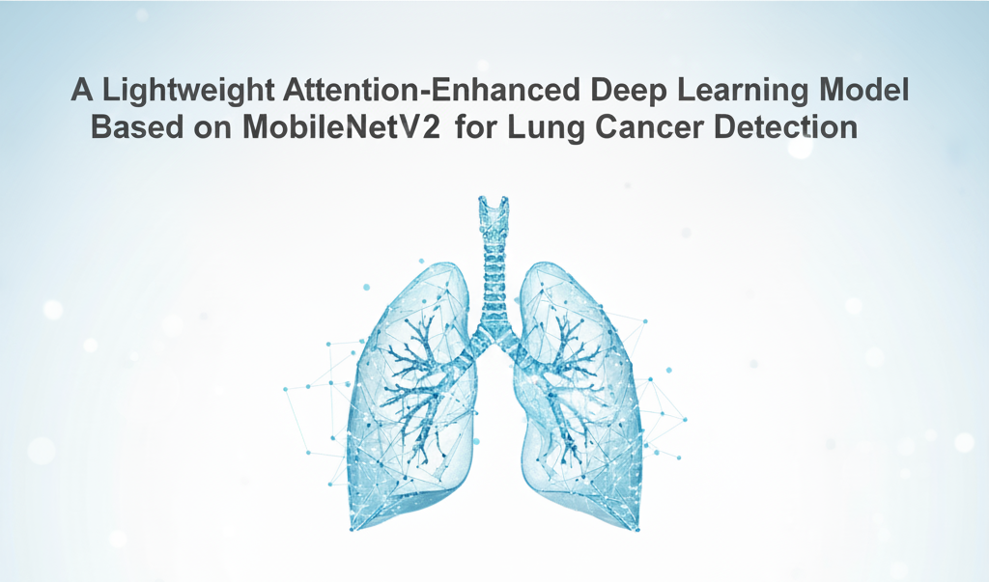
WELCOME
WELCOME

Slide 2
Department of Computer Science and Engineering
A Lightweight Attention-Enhanced Deep Learning Model Based on MobileNetV2 for Lung Cancer Detection
PRESENTED BY
D. Akhil (23475A0508)
Silar Shaik (23475A0512)
P Rahul (22471A05N6)
Under the Guidance of,
Dr.S.N.Tirumala Rao _{M.Tech , Ph.D. ,}
Professor & HOD,
Department of Computer Science and Engineering,
Narasaraopeta Engineering College (Autonomous),
Narasaraopet- 522 601.

Slide 3
OUTLINE
Abstract
Introduction
Literature Survey
Research Gaps
Problem Statement
Objectives
Block Diagram / Flow Diagram
Methodology
Implementation
Results and Analysis
Conclusion & Future Scope
References
Acknowledgements
Question and Answers

Slide 4
ABSTRACT
This work proposes a lightweight deep learning model for early lung cancer detection using CT scan images.
The framework is built on MobileNetV2 enhanced with an attention mechanism to efficiently capture spatial and channel features while maintaining low computational cost.
Using the Kaggle Chest CT-scan dataset with four classes—Adenocarcinoma, Large Cell Carcinoma, Squamous Cell Carcinoma, and Normal—our model achieved 96% accuracy.
The system demonstrates potential for real-time clinical use by combining accuracy, interpretability (via Grad-CAM & LIME), and lightweight architecture suitable for edge devices.

Slide 5
INTRODUCTION
Brief Introduction to the Project
Lung cancer is one of the most fatal cancers due to late diagnosis and limited treatment options. Early detection significantly improves survival rates, but manual CT-scan analysis is time-consuming and prone to human error.
Motivation:
Rising global lung cancer incidence and mortality
Need for automated, reliable, and explainable diagnostic tools
Advancement in deep learning enabling accurate medical image interpretation
Significance: The project integrates AI and clinical imaging for accurate and efficient classification, supporting radiologists in early diagnosis and decision-making.

Slide 6
LITERATURE SURVEY
No | Title | Author | Journal Name & Year | Methodology Adapted | Key Findings | Gaps
1 | A Deep Learning Strategy for Accurate Lung Cancer Subtype Classification Using CNN | Reem S.Z., Sumon S.M.A., Howlader A., Sarker M. | IEEE ICECE, 2024 | CNN-based deep learning framework for CT image subtype classification. | Achieved near-human accuracy using deep spatial features. | Limited interpretability and dataset diversity.
2 | Lung Cancer Detection Based on CT-Scan Images Using GLCM and SVM | Firdaus Q., Sigit R., Harsono T., Anwar A. | IEEE IES, 2020 | Hybrid GLCM + SVM for texture-based cancer detection. | Showed handcrafted features still effective for diagnosis. | Struggles with scalability and noise in CT data.

Slide 7
LITERATURE SURVEY
No | Title | Author | Journal Name & Year | Methodology Adapted | Key Findings | Gaps
3 | Advances in Early Lung Cancer Detection: A Systematic Review | Binson V.A., Subramoniam M. | IEEE ICCSDET, 2018 | Systematic review of imaging and AI methods for early detection. | Summarized evolution from manual to AI-based systems. | No implementation or empirical validation.
4 | A Survey on Detection of Lung Cancer Using Different Image Processing Techniques | Narvekar S., Shirodkar M., Raut T., Vaingankar P., Kumar K.M.C., Aswale S. | IEEE ICIEM, 2022 | Comparative study on segmentation, edge detection, and morphology. | Highlighted need for data-driven automation. | Lacks quantitative comparison of modern CNNs.
5 | Early Stage Detection of Lung Cancer Using Fuzzy Local Information cMean and GoogLeNet | Shafiq S., Asghar M.A., Amjad M.E., Ibrahim J. | IEEE ICOSST, 2022 | Hybrid unsupervised clustering + CNN (GoogLeNet). | Improved accuracy through ROI segmentation. | High computational demand for large datasets.

Slide 8
LITERATURE SURVEY
No | Title | Author | Journal Name & Year | Methodology Adapted | Key Findings | Gaps
6 | Early Lung Cancer Detection in High-Risk Smokers Using an Electronic Nose | McWilliams A., Beigi P., Srinidhi A., Lam S., MacAulay C.E. | IEEE Trans. Biomed. Eng., 2015 | Electronic nose-based sensing for early diagnosis. | Identified biological and behavioral factors affecting detection. | Limited to specific demographics (smokers).
7 | Performance Analysis of Gene Expression Profiles for Lung Cancer Prediction Using JR Algorithm | Vikruthi S., Thippagudisa K.B., Basha P.H., Vamsi P., Chandra G.M., Kiran V.S. | IEEE ICSCNA, 2023 | JR algorithm-based gene expression analysis. | Showed strong potential of molecular data in early diagnosis. | Limited explainability and integration with imaging.
8 | Genetic Algorithm–SVM on Gene Expression Data for Non-Small Cell Lung Cancer | Rohimat T.N.R., Nhita F., Kurniawan I. | IEEE IC2IE, 2022 | Genetic algorithm feature selection + SVM classifier. | Improved classification accuracy on non-smoking female data. | Dataset imbalance and gender bias issues.

Slide 9
LITERATURE SURVEY
No | Title | Author | Journal Name & Year | Methodology Adapted | Key Findings | Gaps
9 | Comparison of Four Transfer Learning and Hybrid CNN Models for Lung Cancer | Sultana A., Khan T.T., Hossain T. | IEEE EICT, 2021 | Ensemble of CNN and transfer learning architectures. | Demonstrated better generalization via model fusion. | Computationally intensive and lacks interpretability.
10 | Early Detection of Lung Cancer Using CT-Based CAD Systems | Mhatre V., Vispute V., Talele K., Mishra N. | IEEE ICCCNT, 2021 | CAD system with CNN for CT image classification. | Enhanced radiologist support and diagnostic speed. | Limited validation on large datasets.

Slide 10
RESEARCH GAPS
Existing CNNs often lack attention mechanisms to focus on key image regions.
Heavy models limit clinical adoption on low-power devices.
Poor interpretability (“black-box” issue) reduces clinician trust.
Need for balanced frameworks that combine accuracy, interpretability, and efficiency.

Slide 11
PROBLEM STATEMENT
To design a lightweight and interpretable deep learning model capable of multi-class lung cancer detection from CT scans, addressing limitations of computational load and clinical interpretability.
Challenges:
Differentiating visually similar lung cancer subtypes
Limited labeled medical datasets
Achieving real-time prediction on edge devices
Goal: Enhance accuracy, transparency, and computational efficiency for reliable clinical deployment.

Slide 12
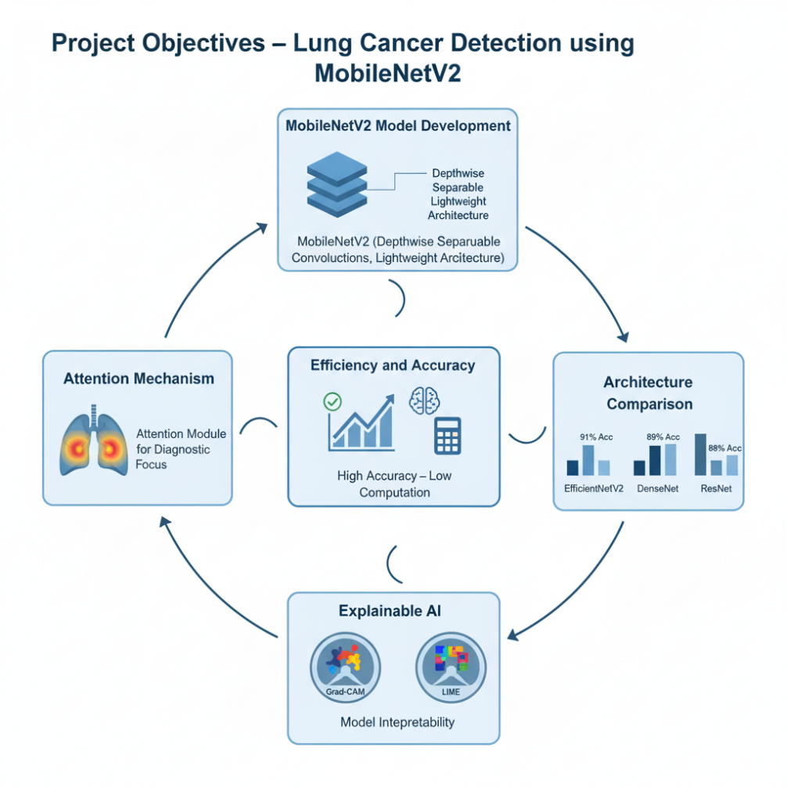
OBJECTIVES
Develop a deep learning model based on MobileNetV2.
Integrate attention mechanisms to highlight diagnostic regions.
Achieve high classification accuracy with minimal resources.
Compare with other architectures (EfficientNetV2, DenseNet, ResNet).
Provide explainable predictions using Grad-CAM and LIME.

Slide 13
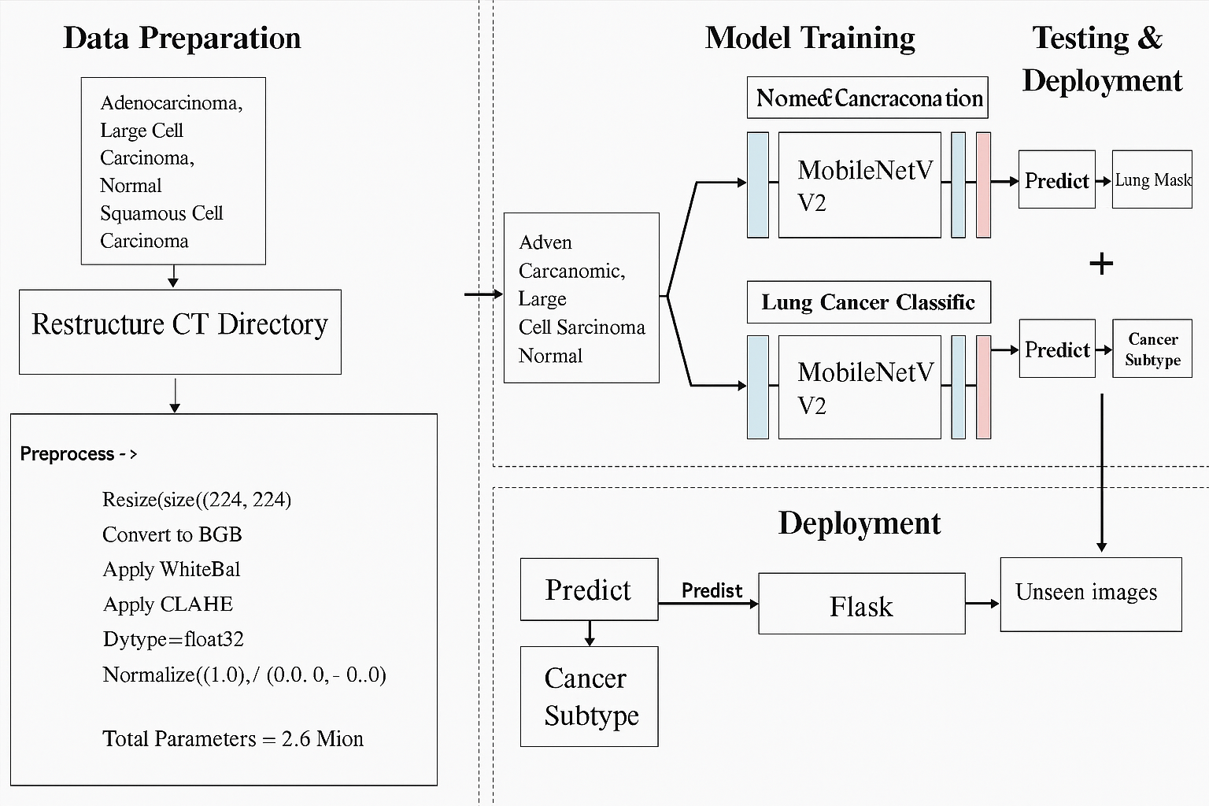
BLOCK DIAGRAM OR FLOW DIAGRAM

Slide 14
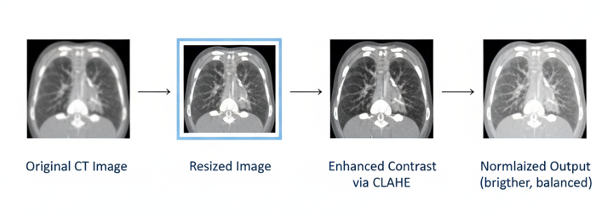
METHODOLOGY
Pre-Processing:
Resize all CT images to 224×224×3.
Convert grayscale scans to RGB for compatibility.
Apply white balancing and CLAHE for contrast enhancement.
Normalize pixel values between 0 and 1.

Slide 15
METHODOLOGY
Model Architecture:
Pretrained MobileNetV2 base (ImageNet weights).
Add Global Average Pooling, Dropout (0.3), and Softmax output.
Fine-tuned on 4 lung cancer classes.
Integrated attention mechanism for feature focus.

Slide 16
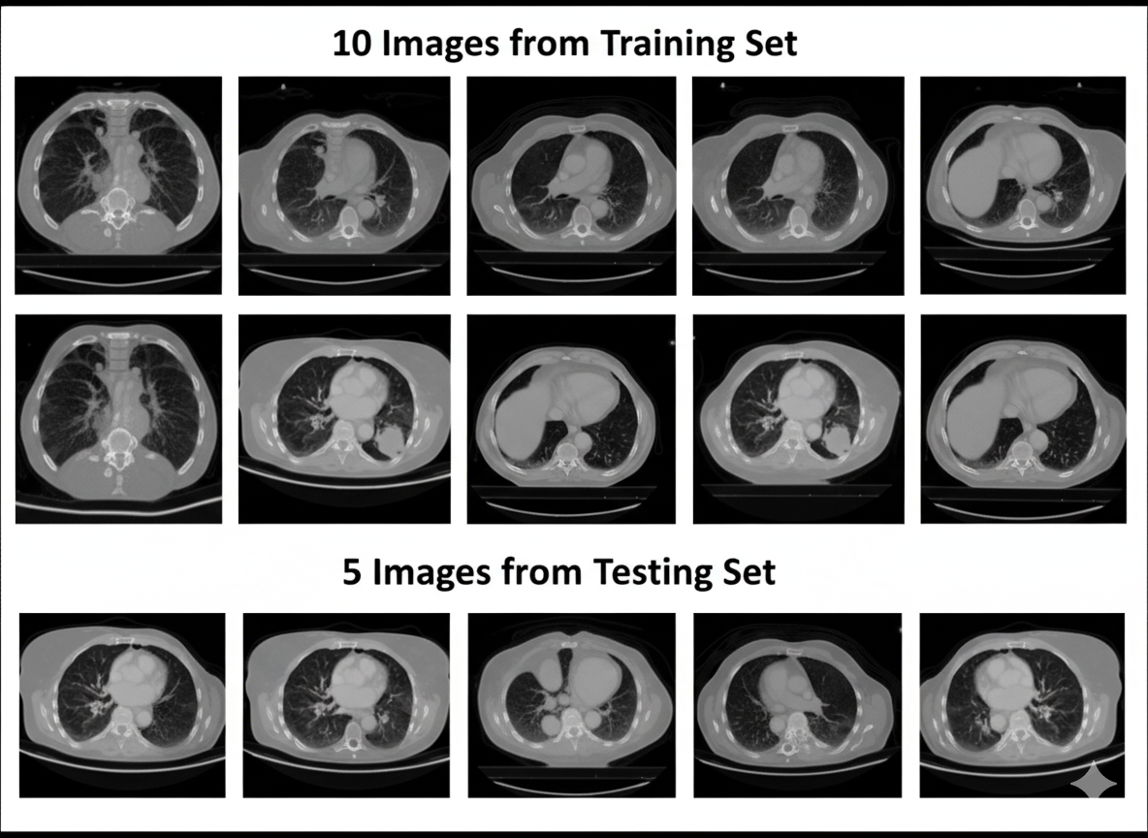
METHODOLOGY

Slide 17
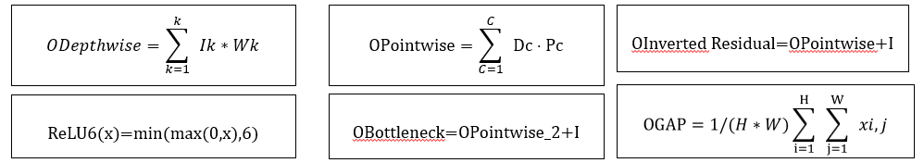
Framework Used:- MobileNetV2
Optimized for medical image classification on low-resource or edge devices.
Uses Depthwise Separable Convolutions to minimize computation while maintaining strong feature learning.
Offers a lightweight yet high-accuracy architecture, ideal for real-time CT scan analysis.Performs effectively in transfer learning scenarios with limited datasets.
Layer(Type) | Output Shape | Param #
mobilenetv2_1.00_128 | (None, 4, 4, 1280) | 4,257,984
global_average_pooling2d | (None, 1280) | 0
dense (Dense) | (None, 256) | 527,936
dropout (Dropout) | (None, 256) | 0
dense_1 (Dense) | (None, 18) | 6,626

Slide 18
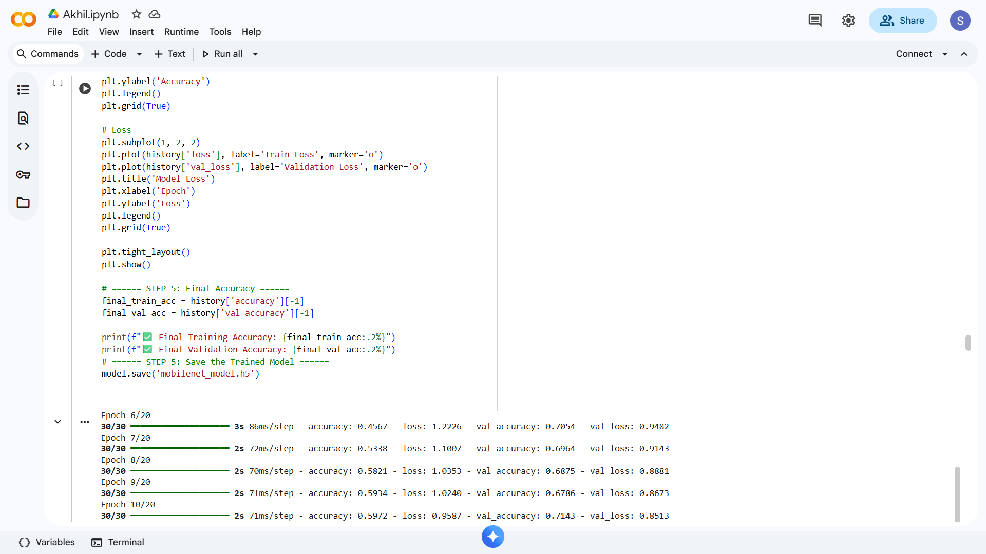
Implementation

Slide 19
System Requirements
Hardware Requirements
Processor : intel Core i5
Cache memory : 4MB(Megabyte)
RAM : 12.7GB (gigabyte)
Hard Disk : 166.8GB
Compute Engine : T4 GPU
Software Requirements
Operating System : Windows 10, 64-bit Operating System
Coding Language : Python
Python distribution : Google Colab , Flask
Browser : Any Latest Browser like Chrome

Slide 20
Challenges Vs Overcomes
Challenges Faced | Solutions Implemented
Overfitting Due to Limited CT Data – The model showed high training accuracy but struggled to generalize on unseen scans. | Data Augmentation – Applied rotation, gamma correction, bilateral filtering, and normalization to improve dataset diversity and reduce overfitting.
High Computational Cost – Training deep models on large CT scans required significant time and GPU memory. | Lightweight Architecture (MobileNetV2) – Used depthwise separable convolutions and optimized T4 GPU execution to minimize processing cost.
Class Imbalance in Dataset – Unequal distribution across the four lung cancer classes led to biased predictions. | Class Balancing – Used oversampling and class weighting to equalize representation of each class during training.
Low Contrast and Noise in CT Images – Variations in scan intensity and background noise affected lesion visibility. | Advanced Preprocessing – Applied white balancing and CLAHE for contrast enhancement and denoising to improve feature clarity.
Lack of Interpretability (Black-Box Nature) – Traditional CNNs lacked transparency for medical decision support. | Explainable AI Integration – Incorporated Grad-CAM and LIME visualizations to highlight diagnostically relevant lung regions.

Slide 21
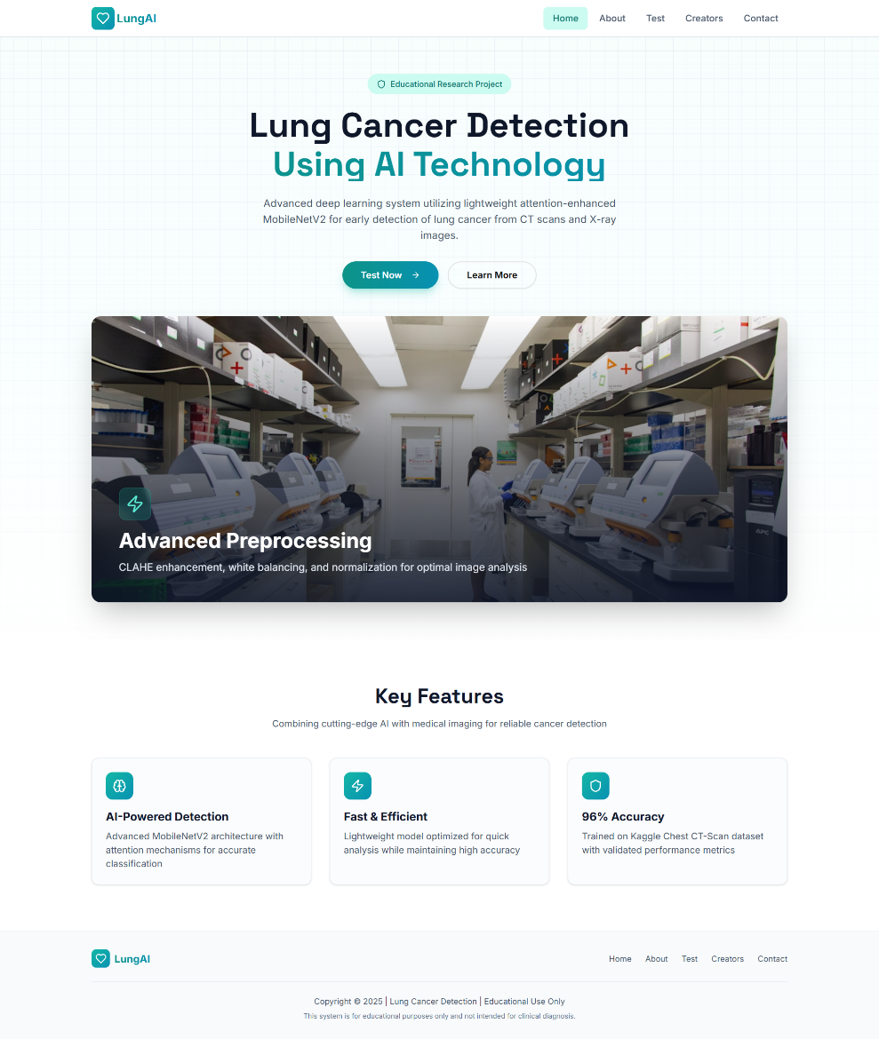
Implementation of Frontend

Slide 22
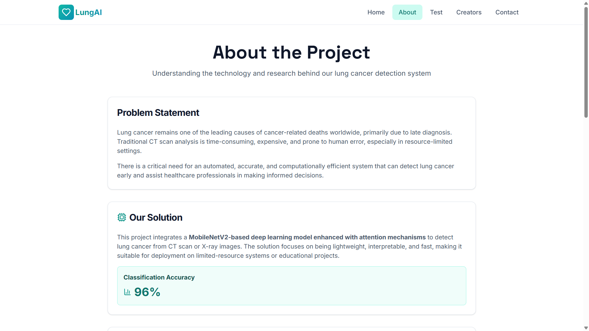

Slide 23
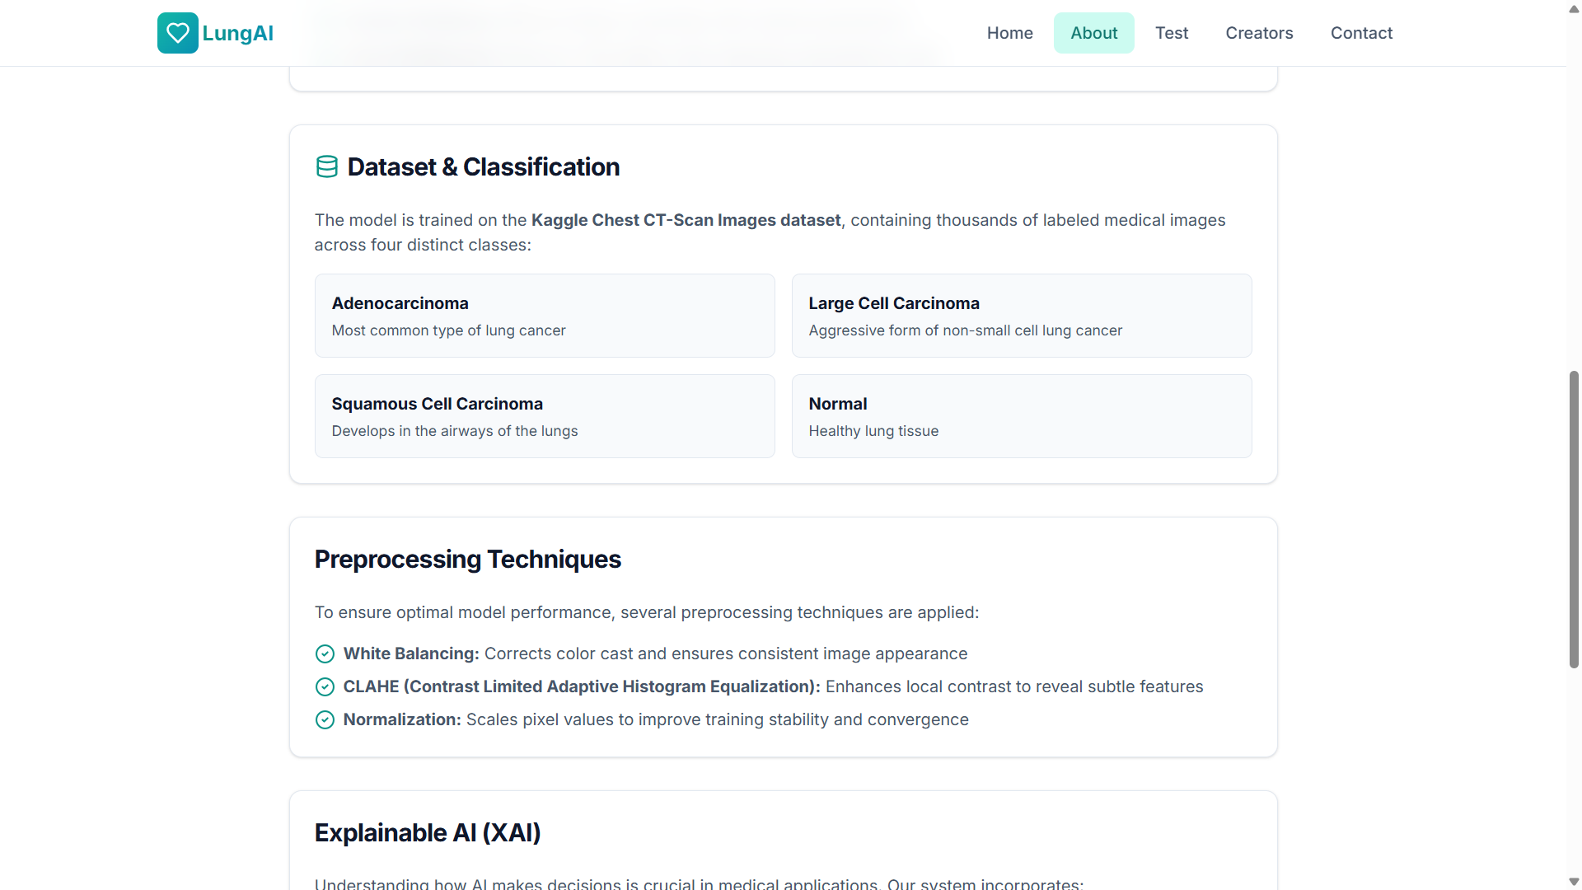

Slide 24
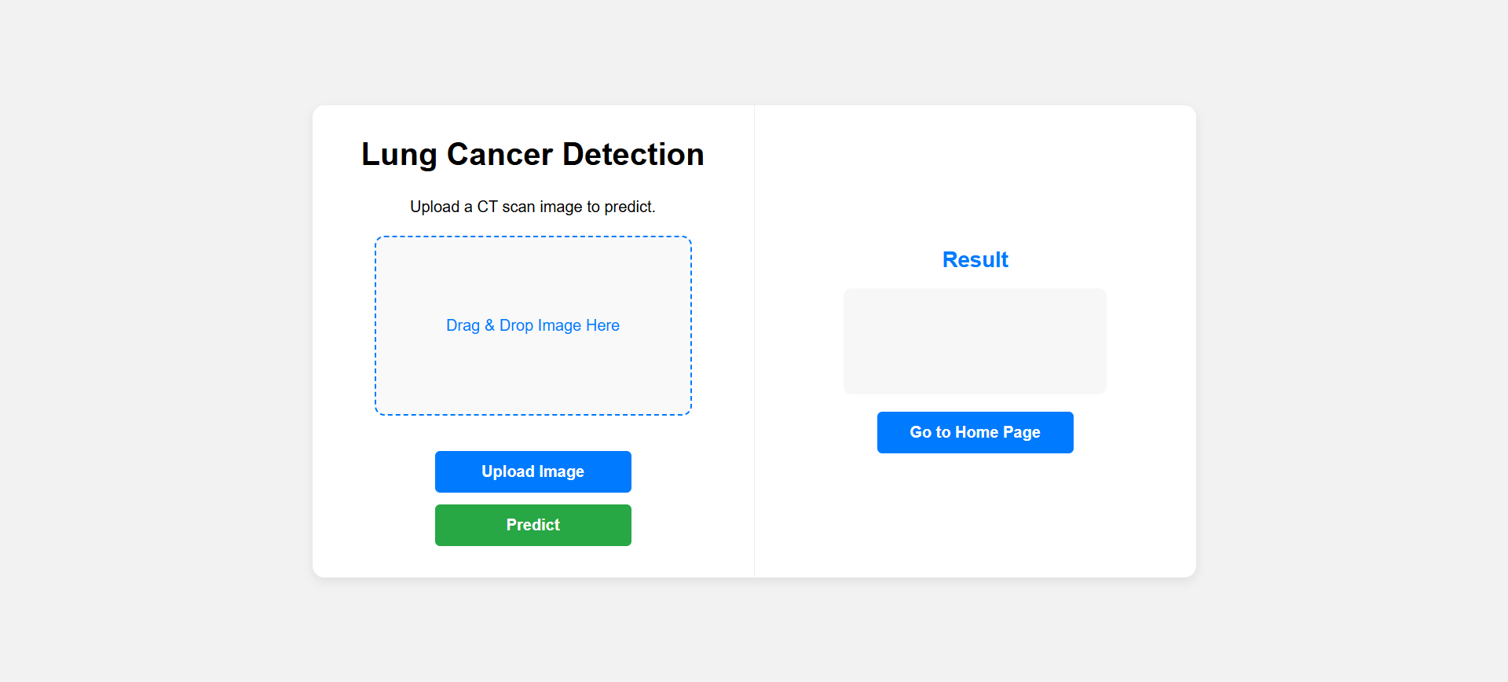
Implementation of Frontend

Slide 25
RESULTS & ANALYSIS
Model | Accuracy | Precision | Recall | F1-Score
MobileNetV2 | 96% | 0.96 | 0.96 | 0.96
EfficientNetV2 | 95% | 0.94 | 0.94 | 0.94
DenseNet121 | 91% | 0.91 | 0.90 | 0.90
ResNet50 | 84% | 0.84 | 0.83 | 0.83
MobileNetV2 outperformed all others with 96% accuracy.
Loss and accuracy curves showed no overfitting.
Attention + Preprocessing improved class separability and reliability.
Include graphs from your paper:
Training vs Validation Accuracy (Fig. 5)
Training vs Validation Loss (Fig. 6)

Slide 26
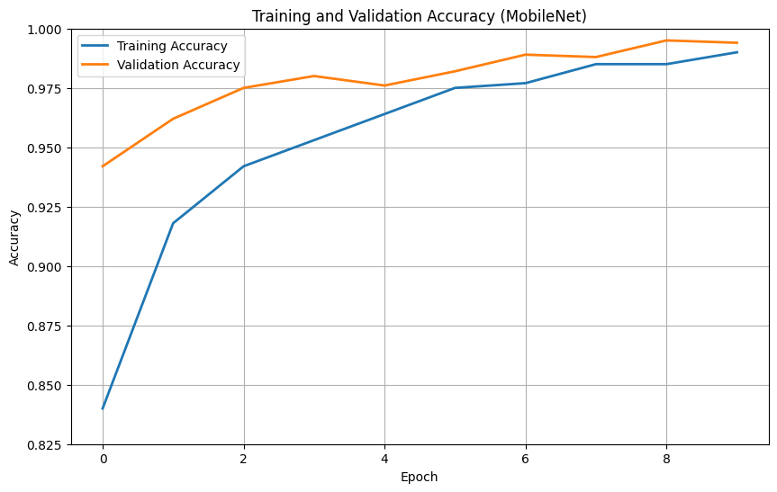
RESULTS & ANALYSIS
The graph depicts that, it can be observed that the training and validation accuracies of MobileNet rise up to 99% in 10 epochs with closely aligned curves.
It is a sign of good generalization without overfitting

Slide 27
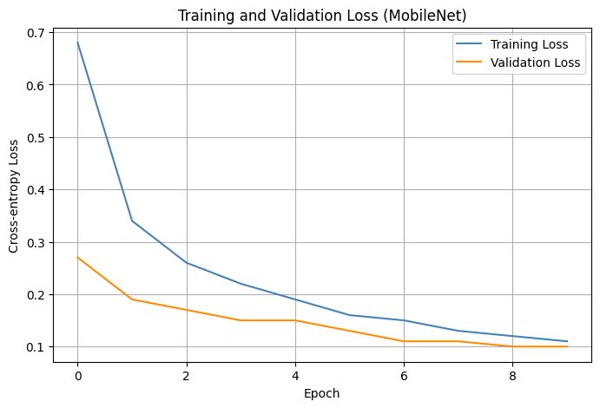
RESULTS & ANALYSIS
The graph depicts that the overall reduction of training and validation losses signifies that the MobileNet model learns well, and both losses are converging to 0.1. Since always the loss for validation is less than that of training.
This hints at good generalization and no signs of overfitting.

Slide 28
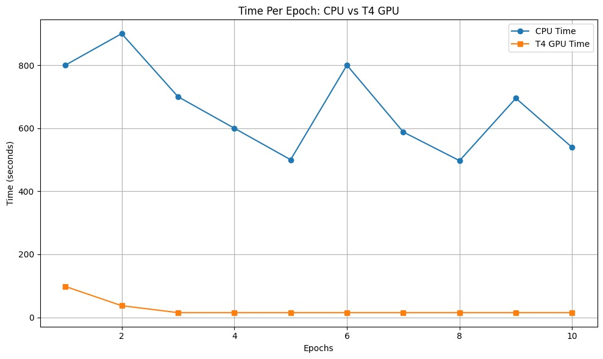
RESULTS & ANALYSIS
The graph depicts that, T4 GPU
significantly reduces the training
time per epoch compared to the
CPU,speeding up model
development and testing.
This makes it important for
high-performance machine
learning experiments.

Slide 29
CONCLUSION & FUTURE SCOPE
The proposed Attention-enhanced MobileNetV2 achieved 96% accuracy and proved effective for early-stage lung cancer classification. It’s lightweight, interpretable, and deployable on real-time clinical systems.
Future Scope:
Expand dataset and add 3D volumetric CT analysis.
Explore federated learning for privacy-preserving training.
Deploy as a cloud/edge-based diagnostic tool.
Improve segmentation to highlight lesion boundaries.

Slide 30
REFERENCES
S. Z. Reem, S. M. A. Sumon, A. Howlader, and M. Sarker, “A Deep Learning Strategy for Accurate Lung Cancer Subtype Classification Using Convolutional Neural Networks,” Proc. 13th Int. Conf. on Electrical and Computer Engineering (ICECE), Dhaka, Bangladesh, 2024, pp. 585–590.
Q. Firdaus, R. Sigit, T. Harsono, and A. Anwar, “Lung Cancer Detection Based on CT-Scan Images with Detection Features Using Gray Level Co-Occurrence Matrix (GLCM) and Support Vector Machine (SVM) Methods,” Int. Electron. Symp. (IES), Surabaya, Indonesia, 2020, pp. 643–648.
V. A. Binson and M. Subramoniam, “Advances in Early Lung Cancer Detection: A Systematic Review,” Int. Conf. on Circuits and Systems in Digital Enterprise Technology (ICCSDET), Kottayam, India, 2018, pp. 1–5.
S. Narvekar et al., “A Survey on Detection of Lung Cancer Using Different Image Processing Techniques,” 3rd Int. Conf. on Intelligent Engineering and Management (ICIEM), London, U.K., 2022, pp. 13–18.
S. Shafiq, M. A. Asghar, M. E. Amjad, and J. Ibrahim, “An Effective Early Stage Detection of Lung Cancer Using Fuzzy Local Information cMean and GoogLeNet,” 16th Int. Conf. on Open Source Systems and Technologies (ICOSST), Lahore, Pakistan, 2022, pp. 1–6.
A. McWilliams et al., “Sex and Smoking Status Effects on the Early Detection of Lung Cancer Using an Electronic Nose,” IEEE Transactions on Biomedical Engineering, vol. 62, no. 8, pp. 2044–2054, Aug. 2015.
S. Vikruthi et al., “Performance Analysis of Gene Expression Profiles of Lung Cancer Prediction Using JR Algorithm,” Int. Conf. on Sustainable Communication Networks and Application (ICSCNA), Theni, India, 2023, pp. 1731–1736.
T. N. R. Rohimat, F. Nhita, and I. Kurniawan, “Implementation of Genetic Algorithm–Support Vector Machine on Gene Expression Data in Identification of Non-Small Cell Lung Cancer in Nonsmoking Female,” 5th Int. Conf. of Computer and Informatics Engineering (IC2IE), Jakarta, Indonesia, 2022, pp. 361–366.
A. Sultana, T. T. Khan, and T. Hossain, “Comparison of Four Transfer Learning and Hybrid CNN Models on Three Types of Lung Cancer,” 5th Int. Conf. on Electrical Information and Communication Technology (EICT), Khulna, Bangladesh, 2021, pp. 1–6.
V. Mhatre, V. Vispute, K. Talele, and N. Mishra, “Early Detection of Lung Cancer Using Computer Aided Tomography Images,” 12th Int. Conf. on Computing Communication and Networking Technologies (ICCCNT), Kharagpur, India, 2021, pp. 1–5.

Slide 31
ACKNOWLEDGEMENTS
We would like to express our gratitude to Dr. K. V. Narasimha Reddy, Professor, Department of CSE, Narasaraopeta Engineering College, for his continuous guidance and support. We also thank the faculty and staff for providing the resources and encouragement that helped us complete this project successfully.
For any questions or further discussions, feel free to reach out:-
Email: akhilduddi95@gmail.com Phone:9550992307
Email: silarpokemon@gmail.com Phone:6305747538
Email: paletirahul718@gmail.com Phone:9989027176

Slide 32
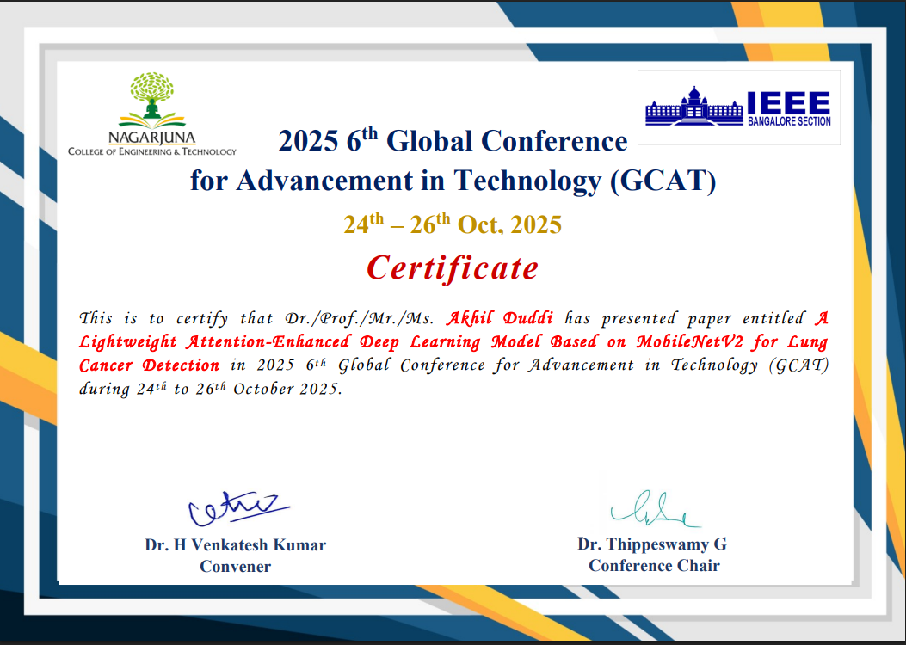

Slide 33


Slide 34


